Slide 1
SSI CSI Local Survey Satisfaction Score May 2020
PT Nissan Motor Indonesia
Customer Quality

Slide 2
CSI & SSI NATIONAL

Slide 3
SSI CSI by Area – April 2020
NATIONAL
SSI | 947
CSI | 884
SSI Target : | 930
CSI Target : | 880
SUMATERA | RESULT | RANK
SSI | 945 | 6
CSI | 890 | 3
RMMG
SSI | 986
CSI | 948
KALIMANTAN | RESULT | RANK
SSI | 916 | 8
CSI | 880 | 4
JKMG
SSI | 919
CSI | 888
SULAWESI | RESULT | RANK
SSI | 955 | 3
CSI | 880 | 5
IMG
SSI | 949
CSI | 878
CENTRAL JAVA | RESULT | RANK
SSI | 963 | 1
CSI | 897 | 2
WSBYG
SSI | 884
CSI | 928
WEST JAVA | RESULT | RANK
SSI | 947 | 5
CSI | 907 | 1
BALI LOMBOK | RESULT | RANK
SSI | 955 | 2
CSI | 872 | 7
DPOG
SSI | 964
CSI | 844
JABODETABEK |  | RESULT | RANK
SSI |  | 944 | 7
CSI |  | 871 | 8
JABO 1 | SSI | 975
 | CSI | 876
JABO 2 | SSI | 925
 | CSI | 868
EAST JAVA | RESULT | RANK
SSI | 951 | 4
CSI | 876 | 6
MPAG
SSI | 960
CSI | 954
 | SSI and CSI Index Region >= Target
 | SSI or CSI Index Region < Target
 | SSI and CSI Index Region < Target
AKAG
SSI | 954
CSI | 886
MUAG
SSI | 0
CSI | 772

Slide 4
SSI CSI by Area – May 2020
NATIONAL
SSI | 940
CSI | 887
SSI Target : | 930
CSI Target : | 880
SUMATERA | RESULT |  | RANK
SSI | 967 |  | 4
CSI | 892 |  | 3
RMMG
SSI | 988
CSI | 866
KALIMANTAN | RESULT |  | RANK
SSI | 0 |  | 8
CSI | 874 |  | 8
JKMG
SSI | 0
CSI | 871
SULAWESI | RESULT |  | RANK
SSI | 980 |  | 3
CSI | 876 |  | 7
IMG
SSI | 935
CSI | 882
CENTRAL JAVA | RESULT |  | RANK
SSI | 999 |  | 1
CSI | 897 |  | 2
WSBYG
SSI | 1,000
CSI | 928
WEST JAVA | RESULT |  | RANK
SSI | 986 |  | 2
CSI | 902 |  | 1
BALI LOMBOK | RESULT |  | RANK
SSI | 0 |  | 7
CSI | 883 |  | 5
DPOG
SSI | 0
CSI | 0
JABODETABEK |  | RESULT |  | RANK
SSI |  | 918 |  | 5
CSI |  | 887 |  | 4
JABO 1 | SSI | 926
 | CSI | 891
JABO 2 | SSI | 902
 | CSI | 884
EAST JAVA | RESULT |  | RANK
SSI | 863 |  | 6
CSI | 878 |  | 6
MPAG
SSI | 937
CSI | 935
 | SSI and CSI Index Region >= Target
 | SSI or CSI Index Region < Target
 | SSI and CSI Index Region < Target
AKAG
SSI | 930
CSI | 900
 | Index Score > previous month
 | Index Score < previous month
 | Index Score = previous month
MUAG
SSI | 0
CSI | 0

Slide 5
SSI CSI by Area – May 2020 – CSA (1/3)
NATIONAL
SSI | 940
CSI | 887
SSI Target : | 930
CSI Target : | 880
JABODETABEK
CSA #1 | RESULT |  | RANK
SSI | 0 |  | 18
CSI | 893 |  | 14
CSA #2 | RESULT |  | RANK
SSI | 0 |  | 19
CSI | 825 |  | 35
CSA #3 | RESULT |  | RANK
SSI | 0 |  | 20
CSI | 916 |  | 8
CSA #4 | RESULT |  | RANK
SSI | 908 |  | 13
CSI | 869 |  | 25
CSA #5 | RESULT |  | RANK
SSI | 1,000 |  | 1
CSI | 880 |  | 20
CSA #6 | RESULT |  | RANK
SSI | 0 |  | 21
CSI | 864 |  | 29
CSA #8 | RESULT |  | RANK
SSI | 0 |  | 22
CSI | 841 |  | 34
CSA #9 | RESULT |  | RANK
SSI | 922 |  | 12
CSI | 887 |  | 16
CSA #10 | RESULT |  | RANK
SSI | 926 |  | 11
CSI | 0 |  | 38
WEST JAVA
CSA #17 | RESULT |  | RANK
SSI | 0 |  | 25
CSI | 941 |  | 5
CSA #18 | RESULT |  | RANK
SSI | 0 |  | 26
CSI | 0 |  | 40
CSA #19 | RESULT |  | RANK
SSI | 0 |  | 27
CSI | 912 |  | 10
CSA #20 | RESULT |  | RANK
SSI | 986 |  | 8
CSI | 965 |  | 2
CSA #21 | RESULT |  | RANK
SSI | 0 |  | 28
CSI | 871 |  | 22
CSA #22 | RESULT |  | RANK
SSI | 0 |  | 29
CSI | 887 |  | 17
CSA #11 | RESULT |  | RANK
SSI | 0 |  | 23
CSI | 866 |  | 28
CSA #12 | RESULT |  | RANK
SSI | 862 |  | 15
CSI | 915 |  | 9
CSA #13 | RESULT |  | RANK
SSI | 930 |  | 10
CSI | 900 |  | 12
CSA #15 | RESULT |  | RANK
SSI | 853 |  | 16
CSI | 894 |  | 13
CSA #16 | RESULT |  | RANK
SSI | 0 |  | 24
CSI | 0 |  | 39
 | SSI and CSI Index Region >= Target
 | SSI or CSI Index Region < Target
 | SSI and CSI Index Region < Target
 | Index Score > previous month
 | Index Score < previous month
 | Index Score = previous month

Slide 6
SSI CSI by Area – May 2020 – CSA (2/3)
NATIONAL
SSI | 940
CSI | 887
SSI Target : | 930
CSI Target : | 880
SUMATERA
CSA #41 | RESULT |  | RANK
SSI | 0 |  | 41
CSI | 960 |  | 3
CSA #42 | RESULT |  | RANK
SSI | 994 |  | 4
CSI | 950 |  | 4
CSA #43 | RESULT |  | RANK
SSI | 873 |  | 14
CSI | 848 |  | 32
CSA #44 | RESULT |  | RANK
SSI | 988 |  | 6
CSI | 866 |  | 27
CSA #45 | RESULT |  | RANK
SSI | 0 |  | 42
CSI | 0 |  | 42
CSA #46 | RESULT |  | RANK
SSI | 987 |  | 7
CSI | 852 |  | 31
CSA #47 | RESULT |  | RANK
SSI | 0 |  | 43
CSI | 0 |  | 43
SULAWESI
CSA #39 | RESULT |  | RANK
SSI | 0 |  | 40
CSI | 864 |  | 30
CSA #40 | RESULT |  | RANK
SSI | 980 |  | 9
CSI | 888 |  | 15
EAST JAVA
CSA #31 | RESULT |  | RANK
SSI | 737 |  | 17
CSI | 848 |  | 33
CSA #32 | RESULT |  | RANK
SSI | 0 |  | 34
CSI | 866 |  | 26
CENTRAL JAVA
CSA #23 | RESULT |  | RANK
SSI | 0 |  | 30
CSI | 869 |  | 24
CSA #25 | RESULT |  | RANK
SSI | 992 |  | 5
CSI | 871 |  | 23
CSA #26 | RESULT |  | RANK
SSI | 1,000 |  | 2
CSI | 815 |  | 36
 | SSI and CSI Index Region >= Target
 | SSI or CSI Index Region < Target
 | SSI and CSI Index Region < Target
 | Index Score > previous month
 | Index Score < previous month
 | Index Score = previous month

Slide 7
SSI CSI by Area – May 2020 – CSA (3/3)
NATIONAL
SSI | 940
CSI | 887
SSI Target : | 930
CSI Target : | 880
KALIMANTAN
CSA #36 | RESULT |  | RANK
SSI | 0 |  | 37
CSI | 790 |  | 37
CSA #37 | RESULT |  | RANK
SSI | 0 |  | 38
CSI | 997 |  | 1
CSA #38 | RESULT |  | RANK
SSI | 0 |  | 39
CSI | 873 |  | 21
UIS SURABAYA
CSA #27 | RESULT |  | RANK
SSI | 0 |  | 31
CSI | 923 |  | 7
CSA #29 | RESULT |  | RANK
SSI | 0 |  | 32
CSI | 904 |  | 11
CSA #30 | RESULT |  | RANK
SSI | 0 |  | 33
CSI | 0 |  | 41
BALI LOMBOK
CSA #33 | RESULT |  | RANK
SSI | 0 |  | 35
CSI | 883 |  | 19
CSA #34 | RESULT |  | RANK
SSI | 0 |  | 36
CSI | 884 |  | 18
SB YOGYAKARTA
CSA #24 | RESULT |  | RANK
SSI | 1,000 |  | 3
CSI | 928 |  | 6
 | SSI and CSI Index Region >= Target
 | SSI or CSI Index Region < Target
 | SSI and CSI Index Region < Target
 | Index Score > previous month
 | Index Score < previous month
 | Index Score = previous month

Slide 8
Executive Summary – SSI CSI National (May 2020)
1. SSI NISSAN INDEX
2. CSI TOTAL INDEX
Overall the results of Nissan's SSI satisfaction in May 2020 are good, compared to the SSI target of 930 and in May 2020 is 947
The factors that make a good score of SSI:
Having the same trend with SSI Nissan, overall satisfaction of CSI is above the target score (+4pts; 880 to 884)
The factors that make a good score of CSI:
Factors | Touch Points
Dealership Personnel | Overall Dealership Personnel (9.70)
Delivery Process | Condition of your vehicle (9.67)
Sales Initiation | Thoroughness of Salesperson to follow up on your enquiries/requests (9.64)
Deal | Ease of coming to agreement on a final deal (9.58)
Dealership Facility | Ease of looking at models on display (9.50)
Paperwork | All of paperworks attributes had a same score (9.48)
Factors | Touch Points
Service Quality (+0.05pts) | Satisfaction with the quality of work performed on your vehicle (8.96)
Vehicle Pickup (+0.05pts) | Satisfaction with vehicle pick-up process from Dealer (9.02)
Service Initiation (+0.03pts) | Flexibility to accommodate schedule (8.96)
Service Advisor (+0.03pts) | Courtesy of Service Advisor (9.20)
Service Facility (+0.03pts) | Cleanliness of dealership (8.87)
3. COMPLIANCE HIGHLIGHT
SSI NISSAN
Low compliance still happened on:
Nissan users are not quite satisfied with the service provided because they are not contacted by sales after the vehicle is delivered
CSI TOTAL
Need to take action on “Vehicle washed and vacuumed after service” and “Service Advisor tell the reason of delay in service time”

Slide 9
OVERALL INDEX NATIONAL

Slide 10
CSI & SSI Trend – National Nissan
Positive score seems on sales performance Nissan and aftersales performance. Its score are going up by 17pts and 4pts. From the target.
Looking into bottom box performance there still 1.7% of the customer dissatisfied on this period.
SSI Index Score Result
CSI Index Score Result
Sample Size
98 | 33
Sample Size
1,315 | 853
SSI Bottom Box Result
CSI Bottom Box Result
Sample Size
2* | 0*
Sample Size
23* | 10*
*read with cautions for small base

Slide 11
Hot Alert – CSI Nissan Datsun National (1/2)
Group |  | Freq (n=11) | Freq (%)
Service Initiation | SI | 1 | 9%
Service Advisor | SA | 3 | 27%
Service Facility | SF | 2 | 18%
Vehicle Pick up | VP | - | -
Service Quality | SQ | 5 | 45%
No | Dealer Code | Dealer Name | Score CSI | OS Score | Group | Verbatim
1 | B1014 | NISSAN JEMUR SARI | 806 | 4 | SA;SQ | Masalah di wipernya, katanya sudah betul wipernya tapi ternyata tidak keluar cairannya.
2 | C5001 | NISSAN SM RAJA | 860 | 5 | SF;SQ | Kalau ada indent tolong hubungi berkala ke customernya,untuk suhu ruangan diperbaiki, kalau sudah dicuci jangan lagi ada noda.
3 | C1015 | NISSAN SM AMIN | 829 | 5 | SF | Agar customer dihubungi setelah service ( 1 minggu )
4 | E1002 | NISSAN MARTADINATA | 671 | 5 | SI;SA;SQ | Peringatan jadwal saya untuk kembali service itu harus pada bulan yang ditentukan, jangan sampai sebelum masuk bulannya sudah diminta datang service. Setelah service harus dirapihkan buku servicenya.
5 | B1011 | NISSAN GATOT SUBROTO BALI | 646 | 5 | SQ | Service agar ditingkatkan jangan melihat mobil tua atau mobil baru.
6 | E1006 | NISSAN PALU | 677 | 4 | SA | Biaya perbaikan dikurangi, harga sprepart dikurangi. perhatian ke pelanggan untuk info status kendaraan untuk evaluasi ke pelanggan, jika alatnya masih bisa digunakan jangan langsung diganti yang baru.
7 | E1005 | NISSAN LATIMOJONG | 617 | 5 | SQ | Saran waktu lebih dipersingkat lebih cepat. perbaikan belum tuntas seperti kurang teliti seperti blowernya kebakar. Agar lebih ada informasi lagi untuk apa keluhan dengan saya.

Slide 12
Hot Alert – SSI Nissan National
- %
Group |  | Freq (n=0) | Freq (%)
Fasilitas Dealer | DF | - | -
Salesperson | SP | - | -
Negosiasi/Deal | Deal | - | -
Proses Administrasi | Adm | - | -
Waktu Pengiriman Kendaraan | DT | - | -
Penyerahan Kendaraan | DP | - | -
No | Dealer Code | Dealer Name | Index Score | OS Score | Group | Verbatim
- | - | - | - | - | - | -

Slide 13
FACTOR COMPARISON NATIONAL

Slide 14











Factor Comparison – SSI & CSI Nissan (National)
For the May period, the delivery process has the highest satisfaction score with 9.53 on SSI
And service advisor has the highest satisfaction score with 9.00 on CSI.
SSI Factor
SSI Score
Sales Initiation
Dealership Facility
Deal
Paperwork
Dealership Personnel
Delivery Process
CSI Factor
CSI Score
Service Initiation
Service Advisor
Service Facility
Vehicle Pickup
Service Quality
Apr’20
May’20
Jun’20

Slide 15
FACTOR ATTRIBUTES COMPARISON NATIONAL

Slide 16


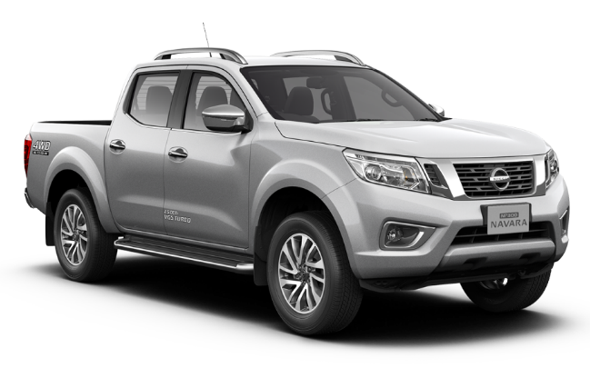
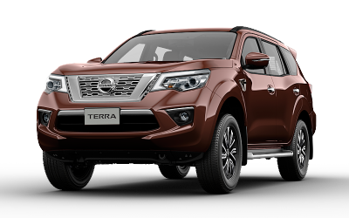
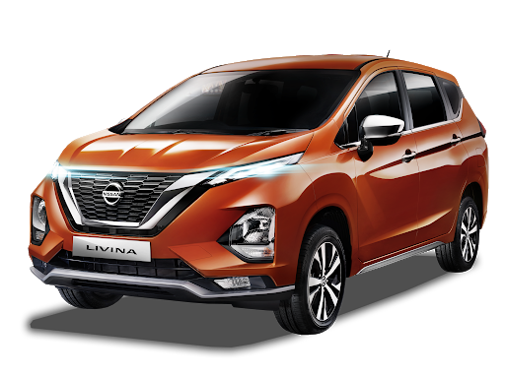
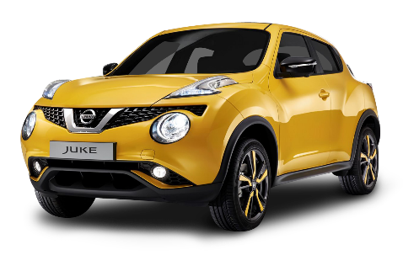
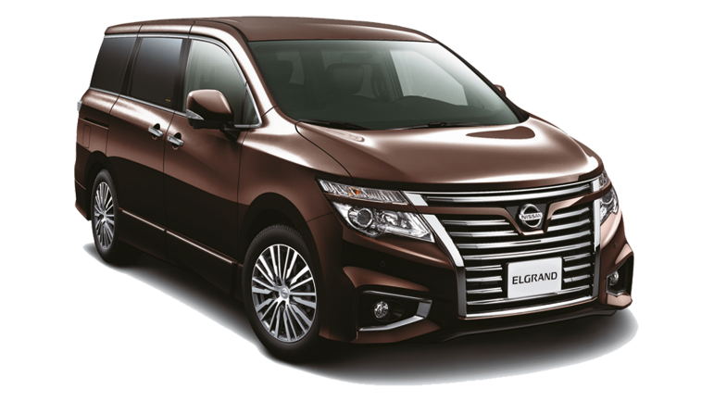
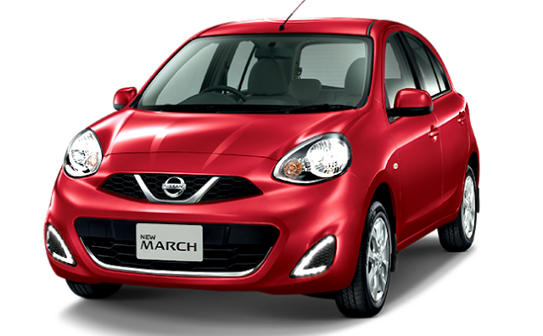
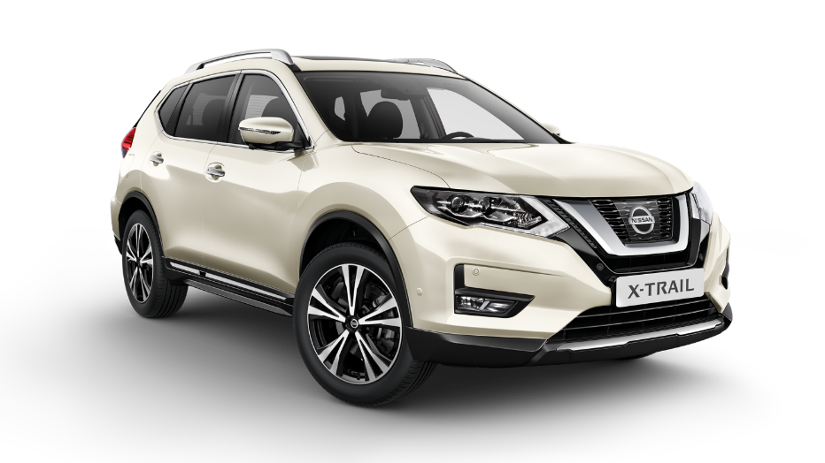
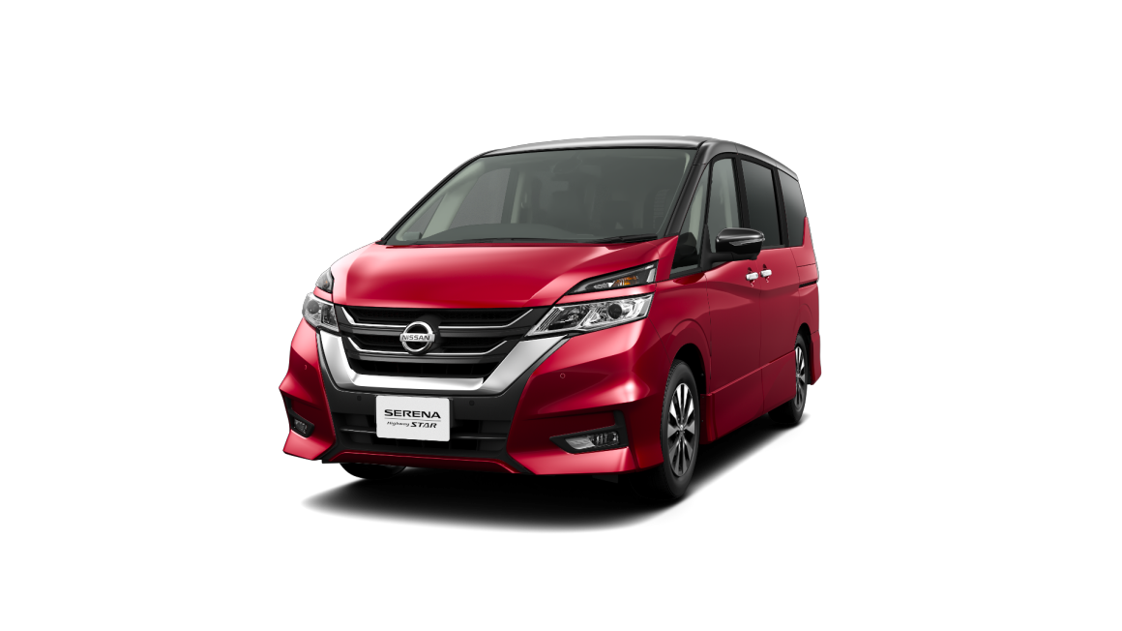
SSI Results

Slide 17


SSI Nissan Score & Compliance Trend – National (1/5)
According to Nissan car buyers, Nissan sales are considered passive because most of them did not offer test drives.
But Nissan car buyers feel young when looking at models on display.
Mean Score
GAP
Base
Apr’20
Base
May’20
Sales Initiation | Overall Satisfaction on Sales Initiation provided by salesperson |  | 0.03
 | Salesperson's explanation of features, advantages, and benefits of vehicle |  | -0.26
 | Overall satisfaction of test drive |  | -0.09
 | Thoroughness of Salesperson to follow up on your enquiries/requests |  | 0.10
Dealership Facility | Overall Satisfaction on Dealer Facility |  | -0.32
 | Comfort in showroom |  | -0.10
 | Ease of looking at models on display |  | -0.12
 | Accessibility of the dealership |  | -0.18
 | Quality of amenities |  | -0.37
98 | 33
98 | 33
80 | 20*
98 | 33
79 | 22*
79 | 22*
79 | 22*
79 | 22*
78 | 22*
May ‘20 (n=33)
Apr ‘20 (n=98)
*read with cautions for small base

Slide 18


SSI Nissan Score & Compliance Trend – National (2/5)
“Ease of coming to agreement on a final deal“ and “Transparency of paperwork/finance process“ are the 2 things that are felt to be
most convenient for buyers when they want to make a deal and take care of the paperwork of the vehicle
Base
Apr’20
Mean Score
GAP
Base
Apr’20
Base
May’20
Deal | Overall rating of the deal |  | -0.11
 | Fairness of vehicle's price paid |  | -0.12
 | Ease of coming to agreement on a final deal |  | -0.07
 | Comfort of location negotiation |  | -0.01
Paperwork | Overall paperwork process |  | 0.06
 | Clarity of explaining documents |  | 0.02
 | Transparency of paperwork/finance process |  | -0.10
 | Timeliness of completing the final paperwork process |  | 0.01
98 | 32
98 | 33
98 | 33
98 | 29*
98 | 33
98 | 33
98 | 33
98 | 33
May ‘20 (n=33)
Apr ‘20 (n=98)
*read with cautions for small base

Slide 19

SSI Nissan Score & Compliance Trend – National (3/5)
Nissan sales in the eyes of its users have served them efficiently and quickly
Mean Score
GAP
Base
Apr’20
Base
May’20
Dealership Personel | Overall Dealership Personnel |  | 0.07
 | Knowledge about vehicles |  | -0.18
 | Serves efficiently and quickly |  | -0.20
 | Concern that you purchase the best vehicle for your needs |  | -0.18
 | Courtesy and friendliness |  | -0.09
 | Transparency of vehicles' price |  | -0.20
 | Use of technology throughout the sales process |  | -0.04
 | Effectiveness of non-face-to-face communication |  | -0.05
98 | 33
98 | 33
98 | 33
98 | 33
98 | 33
97 | 33
98 | 32
98 | 33
May ‘20 (n=33)
Apr ‘20 (n=98)
*read with cautions for small base

Slide 20

SSI Nissan Score & Compliance Trend – National (4/5)
The plus point of Nissan's delivery process is the condition of the vehicle on May period.
Mean Score
GAP
Base
Apr’20
Base
May’20
Delivery Process | Overall rating of the delivery process |  | -0.13
 | Condition of your vehicle |  | -0.03
 | Effectiveness in explaining your vehicle’s features |  | -0.15
 | Timeliness of completing the final delivery |  | -0.18
 | Overall rating of the delivery timing |  | -0.05
 | Length of time needed to deliver your vehicle |  | -0.08
 | Appropriateness of updates regarding your vehicle delivery status |  | -0.03
 | Ability to deliver vehicle at promised date/ time |  | -0.17
97 | 33
98 | 33
98 | 33
98 | 31
98 | 33
97 | 33
98 | 33
98 | 33
May ‘20 (n=33)
Apr ‘20 (n=98)
*read with cautions for small base

Slide 21

SSI Nissan Score & Compliance Trend – National (5/5)
Nissan users are not quite satisfied with the service provided because they are not Introduced to service personnel in service department
Mean Score
GAP
Base
Apr’20
Base
May’20
Follow Up | Overall rating of the delivery process |  | 0.07
98 | 33
Compliance | Delivery Process | Interior and exterior clean and undamaged at delivery
 |  | Sales person explained the reason of lateness in delivery process
 |  | Salesperson delivered the vehicle
 |  | Delivered with special ceremony : Photo session
 |  | Thanked for purchase at delivery
 |  | Introduced to service personnel in service department
 |  | Contacted after delivery
98 | 33
1* | 3*
98 | 33
98 | 33
98 | 33
98 | 33
98 | 33
May ‘20 (n=33)
Apr ‘20 (n=98)
*read with cautions for small base

Slide 22

Follow-up after Vehicle Delivery – SSI Nissan
How long have you been
followed-up after the delivery?
n = 30

Slide 23
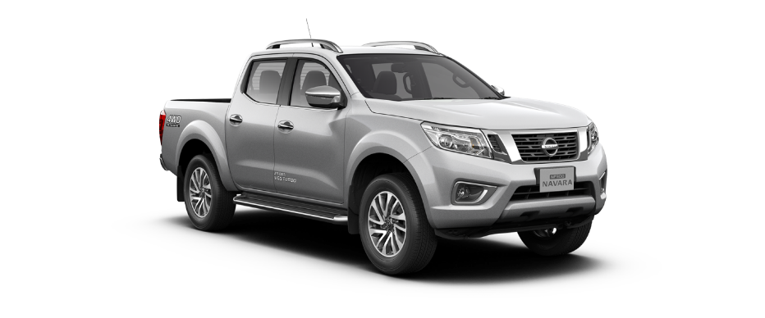
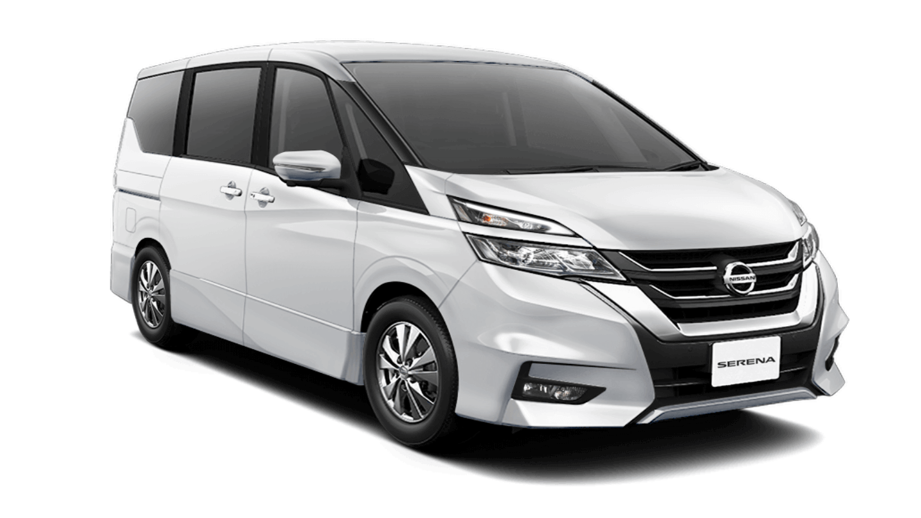
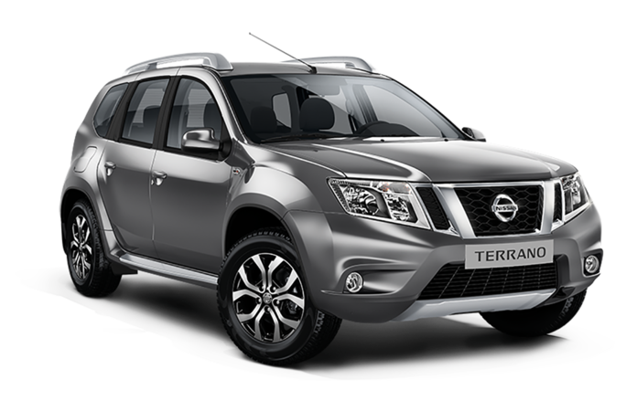
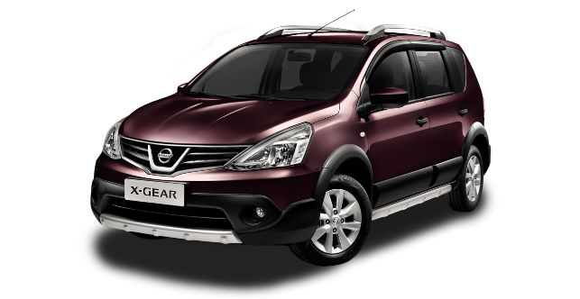

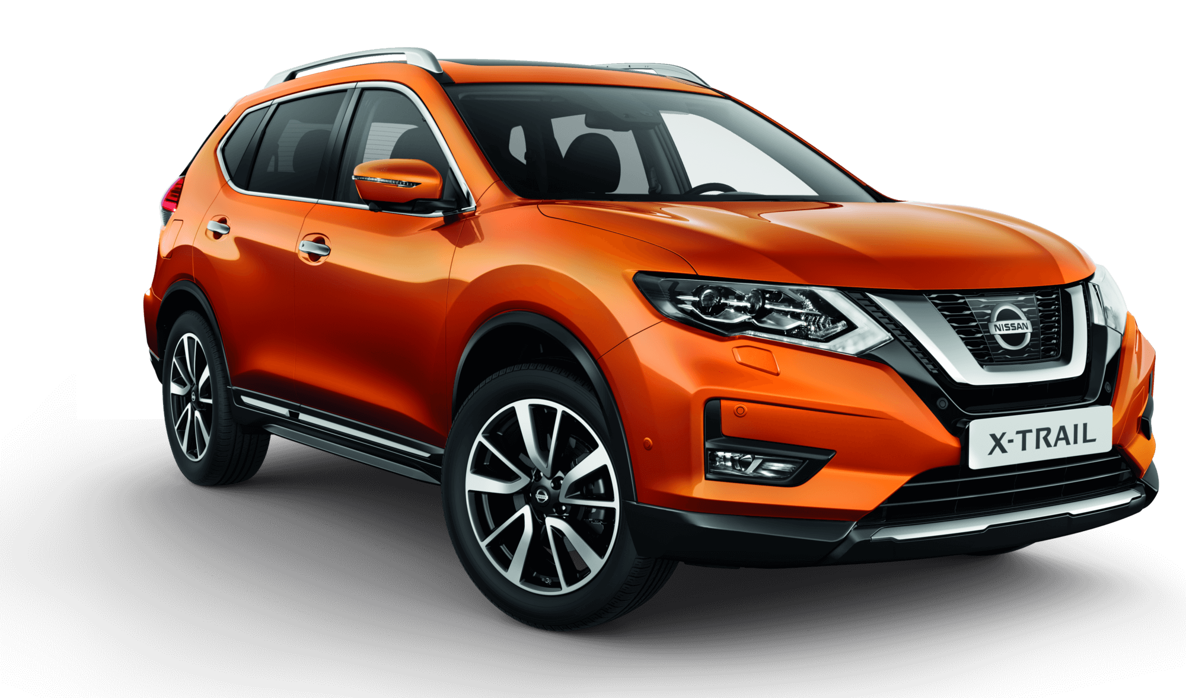

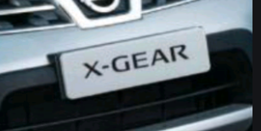

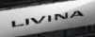
CSI Results

Slide 24

CSI Nissan Datsun Score & Compliance Trend – National (1/4)
Same as April period, timeliness of the handover process is still considered to be one thing that needs to be improved by Nissan.
Base
Apr’20
Mean Score
GAP
Base
Apr’20
Base
May’20
Service Initiation | Satisfaction with service initiation provided by Sales Advisor |  | 0.08
 | Ease of arranging service visit |  | 0.13
 | Flexibility to accommodate schedule |  | 0.08
 | Timeliness of hand over process |  | 0.08
 | Convenient business days/ hours of operation |  | 0.02
1,309 | 850
924 | 765
911 | 751
1,311 | 851
1,311 | 852
May ‘20 (n=853)
Apr ‘20 (n=1,315)
*read with cautions for small base

Slide 25

CSI Nissan Datsun Score & Compliance Trend – National (2/4)
“Courtesy of Service Advisor” is the thing that feels most satisfying to the customers
Base
Apr’20
Mean Score
GAP
Base
Apr’20
Base
May’20
Service Advisor | Satisfaction with service advisor |  | 0.04
 | Courtesy of Service Advisor |  | 0.03
 | Responsiveness of Service Advisor |  | 0.07
 | Thoroughness of Service Advisor explanations |  | 0.06
 | Repeated requests to ensure all understood |  | 0.05
 | Kept you informed of vehicle status |  | 0.06
 | Explanation of work after service completed |  | 0.05
 | Reviewed work done on vehicle |  | 0.07
 | Performed an inspection of vehicle |  | 0.05
1,313 | 853
1,315 | 853
1,313 | 853
1,314 | 853
1,308 | 849
1,297 | 844
1,311 | 852
1,301 | 851
1,297 | 844
May ‘20 (n=853)
Apr ‘20 (n=1,315)
*read with cautions for small base

Slide 26


CSI Nissan Datsun Score & Compliance Trend – National (3/4)
Nissan users feel that the fairness of the charge is still one of the factors that makes Nissan's customer satisfaction down.
Mean Score
GAP
Base
Apr’20
Base
May’20
Service Facility | Satisfaction on service facility |  | -0.04
 | Ease of driving in/out of facility |  | -0.03
 | Convenience of parking location |  | -0.05
 | Cleanliness of dealership |  | -0.02
 | Comfort of waiting area |  | -0.05
Vehicle Pickup | Satisfaction with vehicle pick-up process from Dealer |  | 0.04
 | Timeliness of the pick-up process |  | 0.03
 | Fairness of the charges |  | 0.05
 | Helpfulness of staff at pick-up |  | 0.01
1,306 | 852
1,310 | 851
1,311 | 850
1,313 | 853
1,296 | 836
1,315 | 853
1,315 | 853
1,257 | 806
1,309 | 851
May ‘20 (n=853)
Apr ‘20 (n=1,315)
*read with cautions for small base

Slide 27

CSI Nissan Datsun Score & Compliance Trend – National (4/4)
According to Nissan users, the vehicle was not washed and vacuumed when it was finished servicing.
Base
Apr’20
Mean Score
GAP
Base
Apr’20
Base
May’20
Service Quality | Satisfaction with the quality of work performed on your vehicle |  | 0.11
 | Total time required to service your vehicle |  | 0.04
 | Thoroughness of maintenance/repair work performed |  | 0.07
 | Condition/cleanliness of vehicle on return |  | 0.01
Follow Up | Rating of dealer to follow you up regarding your vehicle services after delivery |  | 0.03
1,315 | 853
1,312 | 852
1,313 | 852
1,311 | 848
1,049 | 675
Compliance | Service Advisor | Service Advisor tell the reason of delay in service time
 | Delivery Process | Work done right first time
 |  | Contacted after service
 |  | Vehicle washed and vacuumed after service
63 | 41
1,315 | 853
1,315 | 853
1,315 | 853
May ‘20 (n=853)
Apr ‘20 (n=1,315)
*read with cautions for small base

Slide 28
Follow-up after Vehicle Delivery – CSI Nissan Datsun
How long have you been
contacted after the service done?
n = 528

Slide 29
DEALER RANKING

Slide 30
Rank Area Dealer by Dealer (National) (1/5)
Type 3S – S.i.S (1/4)
Dealer Name | SSI Nissan | CSI Nissan-Datsun | DPM | DPM Achievement | DPM (Last Month) | DPM Achievement (Last month) | Rank | Rank (Last month) | Rank (+/- last month)
NISSAN BINTARO | 0 | 999 | 999 | 110.34% | 875 | 96.69% | 1 | 70 | 69
NISSAN JEBRES | 997 | 1,000 | 998 | 110.33% | 965 | 106.63% | 2 | 4 | 2
NISSAN AHMAD YANI BANJARMASIN | 0 | 997 | 997 | 110.16% | 841 | 92.88% | 3 | 85 | 82
NISSAN SM RAJA | 991 | 962 | 976 | 107.88% | 997 | 110.16% | 4 | 1 | -3
NISSAN RANCAEKEK | 986 | 965 | 975 | 107.75% | 935 | 103.28% | 5 | 18 | 13
NISSAN SUKABUMI | 0 | 974 | 974 | 107.64% | 966 | 106.78% | 6 | 3 | -3
NISSAN BEKASI BARAT | 976 | 953 | 965 | 106.58% | 954 | 105.41% | 7 | 8 | 1
NISSAN ACEH | 0 | 960 | 960 | 106.09% | 953 | 105.26% | 8 | 10 | 2
NISSAN BANTUL | 0 | 954 | 954 | 105.42% | 878 | 96.96% | 9 | 66 | 57
NISSAN MAGELANG | 0 | 951 | 951 | 105.13% | 944 | 104.29% | 10 | 13 | 3
NISSAN MLATI | 1,000 | 902 | 951 | 105.10% | 936 | 103.44% | 11 | 16 | 5
NISSAN ROXY | 977 | 918 | 948 | 104.71% | 946 | 104.51% | 12 | 11 | -1
NISSAN PALU | 982 | 909 | 945 | 104.47% | 910 | 100.54% | 13 | 40 | 27
NISSAN KUNINGAN | 0 | 943 | 943 | 104.19% | 917 | 101.27% | 14 | 31 | 17
NISSAN SUKAMAJU | 1,000 | 880 | 940 | 103.89% | 914 | 100.99% | 15 | 32 | 17
NISSAN GATOT SUBROTO MEDAN | 0 | 937 | 937 | 103.55% | 932 | 102.96% | 16 | 20 | 4
NISSAN SOEKARNO HATTA | 0 | 928 | 928 | 102.55% | 942 | 104.13% | 17 | 14 | -3
NISSAN MADIUN | 988 | 867 | 928 | 102.51% | 922 | 101.93% | 18 | 24 | 6
NISSAN MARTADINATA | 979 | 876 | 928 | 102.49% | 894 | 98.75% | 19 | 59 | 40
NISSAN BATAM | 988 | 866 | 927 | 102.43% | 967 | 106.84% | 20 | 2 | -18
NISSAN SUNTER | 968 | 883 | 926 | 102.27% | 913 | 100.91% | 21 | 34 | 13
NISSAN CIKUPA | 0 | 924 | 924 | 102.09% | 920 | 101.71% | 22 | 26 | 4
NISSAN NUSA DUA | 0 | 923 | 923 | 102.04% | 865 | 95.57% | 23 | 77 | 54
NISSAN ISTANA | 987 | 857 | 922 | 101.90% | 867 | 95.76% | 24 | 75 | 51
NISSAN TEGAL | 0 | 922 | 922 | 101.89% | 909 | 100.42% | 25 | 41 | 16

Slide 31
Rank Area Dealer by Dealer (National) (2/5)
Type 3S – S.i.S (2/4)
Dealer Name | SSI Nissan | CSI Nissan-Datsun | DPM | DPM Achievement | DPM (Last Month) | DPM Achievement (Last month) | Rank | Rank (Last month) | Rank (+/- last month)
NISSAN JEMUR SARI | 0 | 921 | 921 | 101.74% | 963 | 106.37% | 26 | 5 | -21
NISSAN GUNUNG MALANG | 0 | 917 | 917 | 101.28% | 903 | 99.73% | 27 | 50 | 23
NISSAN CIBUBUR | 0 | 916 | 916 | 101.18% | 903 | 99.76% | 28 | 46 | 18
NISSAN KENDARI | 0 | 914 | 914 | 101.01% | 930 | 102.73% | 29 | 21 | -8
NISSAN PARUNG | 0 | 910 | 910 | 100.58% | 903 | 99.78% | 30 | 44 | 14
NISSAN JATI | 1,000 | 815 | 907 | 100.26% | 913 | 100.90% | 31 | 35 | 4
NISSAN KELAPA GADING | 0 | 904 | 904 | 99.91% | 925 | 102.22% | 32 | 22 | -10
NISSAN INDRAMAYU | 0 | 899 | 899 | 99.35% | 867 | 95.77% | 33 | 74 | 41
NISSAN TOMANG | 923 | 872 | 897 | 99.17% | 905 | 99.95% | 34 | 43 | 9
NISSAN WARUNG BUNCIT | 0 | 896 | 896 | 98.97% | 918 | 101.47% | 35 | 29 | -6
NISSAN SANDUBAYA | 0 | 895 | 895 | 98.94% | 923 | 101.94% | 36 | 23 | -13
NISSAN AHMAD YANI SURABAYA | 0 | 891 | 891 | 98.42% | 887 | 98.06% | 37 | 62 | 25
NISSAN YASMIN | 908 | 869 | 888 | 98.16% | 871 | 96.23% | 38 | 72 | 34
NISSAN BUMI SERPONG DAMAI | 0 | 883 | 883 | 97.61% | 942 | 104.10% | 39 | 15 | -24
NISSAN PROBOLINGGO | 0 | 881 | 881 | 97.31% | 911 | 100.67% | 40 | 38 | -2
NISSAN BANYUWANGI | 0 | 879 | 879 | 97.15% | 838 | 92.55% | 41 | 87 | 46
NISSAN PURWAKARTA | 0 | 876 | 876 | 96.81% | 887 | 98.03% | 42 | 63 | 21
NISSAN HARAPAN INDAH | 875 | 0 | 875 | 96.68% | 862 | 95.25% | 43 | 79 | 36
NISSAN GORONTALO | 0 | 874 | 874 | 96.57% | 900 | 99.41% | 44 | 52 | 8
NISSAN DURI | 873 | 872 | 872 | 96.40% | 836 | 92.34% | 45 | 88 | 43
NISSAN TB SIMATUPANG | 853 | 890 | 871 | 96.28% | 944 | 104.30% | 46 | 12 | -34
NISSAN PURWOKERTO | 0 | 871 | 871 | 96.28% | 903 | 99.77% | 47 | 45 | -2
NISSAN GATOT SUBROTO BALI | 0 | 871 | 871 | 96.20% | 862 | 95.28% | 48 | 78 | 30
NISSAN PANTAI INDAH KAPUK | 0 | 869 | 869 | 96.06% | 888 | 98.12% | 49 | 61 | 12
NISSAN SETIABUDI | 0 | 869 | 869 | 96.05% | 903 | 99.75% | 50 | 47 | -3

Slide 32
Rank Area Dealer by Dealer (National) (3/5)
Type 3S – S.i.S (3/4)
Dealer Name | SSI Nissan | CSI Nissan-Datsun | DPM | DPM Achievement | DPM (Last Month) | DPM Achievement (Last month) | Rank | Rank (Last month) | Rank (+/- last month)
NISSAN VETERAN | 0 | 867 | 867 | 95.75% | 876 | 96.77% | 51 | 68 | 17
NISSAN CIKARANG | 0 | 864 | 864 | 95.48% | 812 | 89.70% | 52 | 91 | 39
NISSAN SOLO BARU | 0 | 862 | 862 | 95.24% | 954 | 105.42% | 53 | 7 | -46
NISSAN KEDAWUNG | 0 | 854 | 854 | 94.36% | 885 | 97.77% | 54 | 64 | 10
NISSAN KUPANG | 0 | 848 | 848 | 93.67% | 828 | 91.54% | 55 | 90 | 35
NISSAN PANGKAL PINANG | 0 | 839 | 839 | 92.66% | 920 | 101.70% | 56 | 27 | -29
NISSAN SEMPAJA | 0 | 837 | 837 | 92.49% | 919 | 101.58% | 57 | 28 | -29
NISSAN PURI INDAH | 0 | 835 | 835 | 92.30% | 896 | 99.00% | 58 | 56 | -2
NISSAN JATAKE | 0 | 825 | 825 | 91.19% | 857 | 94.73% | 59 | 81 | 22
NISSAN SM AMIN | 0 | 823 | 823 | 90.95% | 811 | 89.58% | 60 | 92 | 32
NISSAN PETTARANI | 0 | 822 | 822 | 90.87% | 913 | 100.83% | 61 | 36 | -25
NISSAN ALAM SUTERA | 0 | 822 | 822 | 90.82% | 894 | 98.78% | 62 | 58 | -4
NISSAN JEMBER | 0 | 810 | 810 | 89.46% | 897 | 99.16% | 63 | 53 | -10
NISSAN GIANYAR | 0 | 805 | 805 | 89.00% | 888 | 98.14% | 64 | 60 | -4
NISSAN A.YANI PONTIANAK | 0 | 790 | 790 | 87.28% | 867 | 95.78% | 65 | 73 | 8
NISSAN KEDIRI | 737 | 842 | 790 | 87.28% | 903 | 99.75% | 66 | 49 | -17
NISSAN BEKASI TIMUR | 748 | 792 | 770 | 85.06% | 960 | 106.04% | 67 | 6 | -61
NISSAN GADING SERPONG | 0 | 0 | 0 | 0.00% | 840 | 92.80% | 68 | 86 | 18
NISSAN SILIWANGI | 0 | 0 | 0 | 0.00% | 903 | 99.75% | 69 | 48 | -21
NISSAN DEPOK | 0 | 0 | 0 | 0.00% | 921 | 101.72% | 70 | 25 | -45
NISSAN DAAN MOGOT | 0 | 0 | 0 | 0.00% | 935 | 103.30% | 71 | 17 | -54
NISSAN PLUIT | 0 | 0 | 0 | 0.00% | 912 | 100.76% | 72 | 37 | -35
NISSAN RADIN INTEN | 0 | 0 | 0 | 0.00% | 897 | 99.10% | 73 | 54 | -19
NISSAN PULOGADUNG | 0 | 0 | 0 | 0.00% | 876 | 96.75% | 74 | 69 | -5
NISSAN CINERE | 0 | 0 | 0 | 0.00% | 842 | 93.07% | 75 | 84 | 9

Slide 33
Rank Area Dealer by Dealer (National) (4/5)
Type 3S – S.i.S (4/4)
Dealer Name | SSI Nissan | CSI Nissan-Datsun | DPM | DPM Achievement | DPM (Last Month) | DPM Achievement (Last month) | Rank | Rank (Last month) | Rank (+/- last month)
NISSAN PONDOK INDAH | 0 | 0 | 0 | 0.00% | 906 | 100.10% | 76 | 42 | -34
NISSAN SERANG BARAT | 0 | 0 | 0 | 0.00% | 871 | 96.25% | 77 | 71 | -6
NISSAN SERANG PUSAT | 0 | 0 | 0 | 0.00% | 911 | 100.62% | 78 | 39 | -39
NISSAN KARAWANG | 0 | 0 | 0 | 0.00% | 913 | 100.91% | 79 | 33 | -46
NISSAN CIMAHI | 0 | 0 | 0 | 0.00% | 953 | 105.27% | 80 | 9 | -71
NISSAN JUANDA | 0 | 0 | 0 | 0.00% | 833 | 92.00% | 81 | 89 | 8
NISSAN SALATIGA | 0 | 0 | 0 | 0.00% | 859 | 94.90% | 82 | 80 | -2
NISSAN PEKALONGAN | 0 | 0 | 0 | 0.00% | 896 | 99.04% | 83 | 55 | -28
NISSAN MAJAPAHIT | 0 | 0 | 0 | 0.00% | 866 | 95.66% | 84 | 76 | -8
NISSAN PURI ANJASMORO | 0 | 0 | 0 | 0.00% | 854 | 94.31% | 85 | 83 | -2
NISSAN BASUKI RAHMAT | 0 | 0 | 0 | 0.00% | 895 | 98.92% | 86 | 57 | -29
NISSAN SIDOARJO | 0 | 0 | 0 | 0.00% | 917 | 101.31% | 87 | 30 | -57
NISSAN RTA. MILONO (PALANGKARAYA) | 0 | 0 | 0 | 0.00% | 876 | 96.84% | 88 | 67 | -21
NISSAN ARENGKA | 0 | 0 | 0 | 0.00% | 854 | 94.36% | 89 | 82 | -7
NISSAN KHATIB SULAIMAN | 0 | 0 | 0 | 0.00% | 933 | 103.10% | 90 | 19 | -71
NISSAN P. HIDAYAT | 0 | 0 | 0 | 0.00% | 900 | 99.47% | 91 | 51 | -40
NISSAN SOEKARNO HATTA PLG | 0 | 0 | 0 | 0.00% | 772 | 85.33% | 92 | 93 | 1
NISSAN LABUHAN RATU | 0 | 0 | 0 | 0.00% | 881 | 97.36% | 93 | 65 | -28

Slide 34
Rank Area Dealer by Dealer (National) (5/5)
Type 3S – NE
Dealer Name | SSI Nissan | CSI Nissan-Datsun | DPM | DPM Achievement | DPM (Last Month) | DPM Achievement (Last month) | Rank | Rank (Last month) | Rank (+/- last month)
NISSAN AMIR HAMZAH | 997 | 938 | 968 | 106.91% | 943 | 104.20% | 1 | 2 | 1
NISSAN CITRALAND SURABAYA | 0 | 923 | 923 | 102.02% | 994 | 109.88% | 2 | 1 | -1
NISSAN S. PARMAN | 0 | 860 | 860 | 95.02% | 831 | 91.86% | 3 | 4 | 1
NISSAN LATIMOJONG | 0 | 820 | 820 | 90.58% | 936 | 103.45% | 4 | 3 | -1
Type 3S – DE
Dealer Name | SSI Nissan | CSI Nissan-Datsun | DPM | DPM Achievement | DPM (Last Month) | DPM Achievement (Last month) | Rank | Rank (Last month) | Rank (+/- last month)
DATSUN ADAM MALIK | 0 | 979 | 979 | 108.18% | 906 | 100.07% | 1 | 1 | 0
DATSUN S.PARMAN | 0 | 0 | 0 | 0.00% | 897 | 99.15% | 2 | 2 | 0
Type 3S – S.i.S
Dealer Name | SSI Nissan | CSI Nissan-Datsun | DPM | DPM Achievement | DPM (Last Month) | DPM Achievement (Last month) | Rank | Rank (Last month) | Rank (+/- last month)
NISSAN MT. HARYONO | 926 | 0 | 926 | 102.35% | 884 | 97.70% | 1 | 1 | 0
NISSAN MOJOKERTO | 0 | 0 | 0 | 0.00% | 0 | 0.00% | 2 | 2 | 0
NISSAN TEGALREJO | 0 | 0 | 0 | 0.00% | 0 | 0.00% | 3 | 3 | 0
Type 2S
Dealer Name | SSI Nissan | CSI Nissan-Datsun | DPM | DPM Achievement | DPM (Last Month) | DPM Achievement (Last month) | Rank | Rank (Last month) | Rank (+/- last month)
NISSAN HALIM | 0 | 922 | 922 | 101.85% | 876 | 96.82% | 1 | 2 | -1
NISSAN KOMBOS | 0 | 0 | 0 | 0.00% | 919 | 101.51% | 2 | 1 | 1

Slide 35
Customer Service Area Ranking – May 2020 (1/2)
CSA | Dealer Name | SSI Nissan | CSI Nissan-Datsun | DPM | DPM Achievement | DPM (Last Month) | DPM Achievement (Last month) | Rank | Rank (Last month) | Rank (+/- last month)
CSA #37 | IMG | 0 | 997 | 997 | 110.16% | 841 | 92.88% | 1 | 42 | 41
CSA #42B | MPA | 991 | 962 | 976 | 107.88% | 997 | 110.16% | 2 | 1 | -1
CSA #20 | MPA | 986 | 965 | 975 | 107.75% | 935 | 103.28% | 3 | 11 | 8
CSA #42 | IMG | 997 | 943 | 970 | 107.16% | 942 | 104.08% | 4 | 9 | 5
CSA #24 | SB/Yogyakarta | 1,000 | 928 | 964 | 106.54% | 906 | 100.13% | 5 | 25 | 20
CSA #41 | IMG | 0 | 960 | 960 | 106.09% | 953 | 105.26% | 6 | 6 | 0
CSA #17 | IMG | 0 | 941 | 941 | 104.03% | 932 | 102.96% | 7 | 12 | 5
CSA #5 | IMG | 1,000 | 880 | 940 | 103.89% | 913 | 100.86% | 8 | 20 | 12
CSA #40 | IMG | 980 | 888 | 934 | 103.21% | 905 | 99.96% | 9 | 27 | 18
CSA #25 | IMG | 992 | 871 | 932 | 102.96% | 950 | 104.97% | 10 | 7 | -3
CSA #44 | RMM | 988 | 866 | 927 | 102.43% | 967 | 106.84% | 11 | 2 | -9
CSA #10 | IMG | 926 | 0 | 926 | 102.35% | 886 | 97.93% | 12 | 34 | 22
CSA #27 | SB/Yogyakarta | 0 | 923 | 923 | 102.02% | 901 | 99.55% | 13 | 31 | 18
CSA #46 | IMG | 987 | 852 | 920 | 101.63% | 911 | 100.62% | 14 | 22 | 8
CSA #3 | IMG | 0 | 916 | 916 | 101.18% | 907 | 100.22% | 15 | 24 | 9
CSA #13 | AKA | 930 | 900 | 915 | 101.14% | 920 | 101.70% | 16 | 15 | -1
CSA #19 | IMG | 0 | 912 | 912 | 100.74% | 920 | 101.67% | 17 | 16 | -1
CSA #26 | IMG | 1,000 | 815 | 907 | 100.26% | 913 | 100.90% | 18 | 19 | 1
CSA #29 | SB/Yogyakarta | 0 | 904 | 904 | 99.91% | 954 | 105.38% | 19 | 4 | -15
CSA #9 | IMG | 922 | 887 | 904 | 99.90% | 912 | 100.77% | 20 | 21 | 1
CSA #1 | IMG | 0 | 893 | 893 | 98.69% | 892 | 98.57% | 21 | 33 | 12
CSA #12 | MPA | 862 | 915 | 889 | 98.18% | 956 | 105.59% | 22 | 3 | -19
CSA #4 | IMG | 908 | 869 | 888 | 98.16% | 871 | 96.23% | 23 | 37 | 14
CSA #22 | IMG | 0 | 887 | 887 | 97.96% | 943 | 104.22% | 24 | 8 | -16
CSA #34 | IMG | 0 | 884 | 884 | 97.69% | 914 | 101.00% | 25 | 18 | -7

Slide 36
Customer Service Area Ranking – May 2020 (2/2)
CSA | Dealer Name | SSI Nissan | CSI Nissan-Datsun | DPM | DPM Achievement | DPM (Last Month) | DPM Achievement (Last month) | Rank | Rank (Last month) | Rank (+/- last month)
CSA #33 | IMG | 0 | 883 | 883 | 97.59% | 871 | 96.21% | 26 | 38 | 12
CSA #15 | IMG | 853 | 894 | 874 | 96.54% | 908 | 100.31% | 27 | 23 | -4
CSA #38 | IMG | 0 | 873 | 873 | 96.48% | 925 | 102.23% | 28 | 14 | -14
CSA #21 | IMG | 0 | 871 | 871 | 96.28% | 869 | 96.05% | 29 | 40 | 11
CSA #23 | IMG | 0 | 869 | 869 | 96.05% | 899 | 99.34% | 30 | 32 | 2
CSA #32 | IMG | 0 | 866 | 866 | 95.74% | 885 | 97.81% | 31 | 35 | 4
CSA #11 | JKM | 0 | 866 | 866 | 95.65% | 903 | 99.79% | 32 | 29 | -3
CSA #6 | IMG | 0 | 864 | 864 | 95.48% | 812 | 89.70% | 33 | 44 | 11
CSA #39 | IMG | 0 | 864 | 864 | 95.43% | 929 | 102.69% | 34 | 13 | -21
CSA #43 | IMG | 873 | 848 | 861 | 95.11% | 837 | 92.43% | 35 | 43 | 8
CSA #8 | IMG | 0 | 841 | 841 | 92.93% | 905 | 100.02% | 36 | 26 | -10
CSA #2 | IMG | 0 | 825 | 825 | 91.19% | 857 | 94.73% | 37 | 41 | 4
CSA #31 | IMG | 737 | 848 | 793 | 87.58% | 903 | 99.78% | 38 | 30 | -8
CSA #36 | IMG | 0 | 790 | 790 | 87.28% | 869 | 96.07% | 39 | 39 | 0
CSA #16 | DPO | 0 | 0 | 0 | 0.00% | 904 | 99.92% | 40 | 28 | -12
CSA #18 | IMG | 0 | 0 | 0 | 0.00% | 953 | 105.27% | 41 | 5 | -36
CSA #30 | SB/Yogyakarta | 0 | 0 | 0 | 0.00% | 917 | 101.31% | 42 | 17 | -25
CSA #45 | IMG | 0 | 0 | 0 | 0.00% | 936 | 103.42% | 43 | 10 | -33
CSA #47 | IMG | 0 | 0 | 0 | 0.00% | 881 | 97.36% | 44 | 36 | -8

Slide 37
REGION INDEX SCORE

Slide 38
CSI & SSI Trend – SUMATERA (May 2020)
SSI NISSAN Index Score Result
CSI Index Score Result
Sample Size
12* | 5*
Sample Size
207 | 111
*read with cautions for small base

Slide 39
CSI & SSI Trend – JABODETABEK (May 2020)
SSI NISSAN Index Score Result
CSI Index Score Result
Sample Size
42 | 18*
Sample Size
363 | 264
*read with cautions for small base

Slide 40
CSI & SSI Trend – WEST JAVA (May 2020)
SSI NISSAN Index Score Result
CSI Index Score Result
Sample Size
8* | 2*
Sample Size
140 | 75
*read with cautions for small base

Slide 41
CSI & SSI Trend – CENTRAL JAVA (May 2020)
SSI NISSAN Index Score Result
CSI Index Score Result
Sample Size
12* | 4*
Sample Size
200 | 110
*read with cautions for small base

Slide 42
CSI & SSI Trend – EAST JAVA (May 2020)
SSI NISSAN Index Score Result
CSI Index Score Result
Sample Size
14* | 2*
Sample Size
159 | 91
*read with cautions for small base

Slide 43
CSI & SSI Trend – BALI LOMBOK (May 2020)
SSI NISSAN Index Score Result
CSI Index Score Result
Sample Size
2* | 0*
Sample Size
79 | 62
*read with cautions for small base

Slide 44
CSI & SSI Trend – KALIMANTAN (May 2020)
SSI NISSAN Index Score Result
CSI Index Score Result
Sample Size
4* | 0*
Sample Size
73 | 40
*read with cautions for small base

Slide 45
CSI & SSI Trend – SULAWESI (May 2020)
SSI NISSAN Index Score Result
CSI Index Score Result
Sample Size
4* | 2*
Sample Size
94 | 100
*read with cautions for small base

Slide 46
DATABASE ACHIEVEMENT

Slide 47
SSI & CSI Achievement – Nissan Datsun
 | Sample Size Achievement |  | Sample Size Required |  | Total Sample Provided By Nissan |  | % Achievement
 | SSI Nissan | CSI | SSI Nissan | CSI | SSI Nissan | CSI | SSI Nissan | CSI
Apr 2020 | 98 | 1,315 | 1,040 | 3,640 | 216 | 4,343 | 45% | 36%
May 2020 | 33 | 853 | 1,040 | 3,640 | 57 | 2,163 | 58% | 23%
Jun 2020
Jul 2020
Aug 2020
Sep 2020
Oct 2020
Nov 2020
Dec 2020
Jan 2021
Feb 2021
Mar 2021

Slide 48
SSI Nissan Achievement – May 2020
 | Number of Dealers | SSI Achievement | Sample Size Required | Sample Provided by Nissan | % Achievement | Total Interview | Failed Interview |  | % Invalid Data
 |  |  |  |  |  |  | Screening Process | Invalid Data
National | 23 | 33 | 1,040 | 57 | 58 | 57 | 6 | 16 | 28%
Sumatera | 5 | 5 | 150 | 12 | 42 | 12 | 2 | 5 | 42%
Jabodetabek | 10 | 18 | 340 | 25 | 72 | 25 | 2 | 5 | 20%
West Java | 1 | 2 | 110 | 2 | 100 | 2 | 0 | 0 | 0%
Central Java | 3 | 4 | 140 | 5 | 80 | 5 | 0 | 1 | 20%
East Java | 2 | 2 | 120 | 8 | 25 | 8 | 2 | 2 | 25%
Sulawesi | 2 | 2 | 80 | 4 | 50 | 4 | 0 | 2 | 50%
Bali Lombok | 0 | 0 | 50 | 0 | 0 | 0 | 0 | 0 | 0%
Kalimantan | 0 | 0 | 50 | 1 | 0 | 1 | 0 | 1 | 100%

Slide 49
CSI Nissan Datsun Achievement – May 2020
 | Number of Dealers | CSI Achievement | Sample Size Required | Sample Provided by Nissan | % Achievement | Total Interview | Failed Interview |  | % Invalid Data
 |  |  |  |  |  |  | Screening Process | Invalid Data
National | 72 | 853 | 3,640 | 2,163 | 39 | 2,163 | 394 | 912 | 42%
Sumatera | 10 | 111 | 525 | 254 | 44 | 254 | 50 | 93 | 37%
Jabodetabek | 21 | 264 | 1,190 | 703 | 38 | 703 | 153 | 284 | 40%
West Java | 8 | 75 | 385 | 163 | 46 | 163 | 24 | 63 | 39%
Central Java | 9 | 110 | 490 | 245 | 45 | 245 | 27 | 108 | 44%
East Java | 9 | 91 | 420 | 237 | 38 | 237 | 45 | 101 | 43%
Sulawesi | 6 | 100 | 280 | 285 | 35 | 285 | 48 | 137 | 48%
Bali Lombok | 5 | 62 | 175 | 166 | 37 | 166 | 23 | 80 | 48%
Kalimantan | 4 | 40 | 175 | 110 | 36 | 110 | 24 | 46 | 42%

Slide 50
Main Reason for Invalid Data of SSI Nissan
 | REASONS | % of NOT SUCCESS Apr 2020 | % of NOT SUCCESS May 2020 | % of NOT SUCCESS Jun 2020 | % of NOT SUCCESS Jul 2020 | % of NOT SUCCESS Aug 2020 | % of NOT SUCCESS Sep 2020 | % of NOT SUCCESS Oct 2020 | % of NOT SUCCESS Nov 2020 | % of NOT SUCCESS Dec 2020 | % of NOT SUCCESS Jan 2021 | % of NOT SUCCESS Feb 2021 | % of NOT SUCCESS Mar 2021
Personal Reason | Has different name with database | 5.56% | 3.51%
 | Have not received car from Nissan | 0.00% | 1.75%
 | Never visit the dealer | 0.00% | 0.00%
 | Cars have been sold to others | 0.00% | 0.00%
Technical Reason | Mailbox | 3.24% | 0.00%
 | Number are not active | 6.48% | 3.51%
 | No signal/ no dial tone | 0.46% | 0.00%
 | Phone number are diverted | 3.24% | 1.75%
 | Phone number are incomplete | 0.00% | 0.00%
 | Unlisted number | 0.00% | 0.00%
 | Could not be contacted | 3.24% | 0.00%
 | "Tulalit" tone | 0.00% | 0.00%
 | Phone number belonging to someone else (husband / wife / child / driver / etc) | 0.46% | 1.75%
 | Wrong number | 0.46% | 0.00%

Slide 51
Main Reason for Invalid Data of CSI Nissan
 | REASONS | % of NOT SUCCESS Apr 2020 | % of NOT SUCCESS May 2020 | % of NOT SUCCESS Jun 2020 | % of NOT SUCCESS Jul 2020 | % of NOT SUCCESS Aug 2020 | % of NOT SUCCESS Sep 2020 | % of NOT SUCCESS Oct 2020 | % of NOT SUCCESS Nov 2020 | % of NOT SUCCESS Dec 2020 | % of NOT SUCCESS Jan 2021 | % of NOT SUCCESS Feb 2021 | % of NOT SUCCESS Mar 2021
Personal Reason | Has different name with database | 0.81% | 2.17%
 | Cars have been sold to others | 1.31% | 0.42%
Technical Reason | Mailbox | 5.76% | 1.11%
 | Number are not active | 9.47% | 1.43%
 | No signal/ no dial tone | 1.20% | 0.05%
 | Phone number are diverted | 1.68% | 1.16%
 | Phone number are incomplete | 0.35% | 0.09%
 | Unlisted number | 3.50% | 0.74%
 | Could not be contacted | 1.52% | 2.45%
 | "Tulalit" tone | 0.14% | 0.00%
 | Phone number belonging to someone else (husband / wife / child / driver / etc) | 1.18% | 1.11%
 | Wrong number | 0.92% | 1.11%

Slide 52
Thank
You

